Slide 1
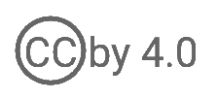
User Account Management
WSO2 Identity Server Fundamentals

Slide 2




User Account
The digital representation of a physical user who interacts with an application
Application User Account
[Jane Doe]
User Name
@
Password
Thumbprint
Application User
[Jane Doe]
Identity Provider (IdP)
WSO2 Identity Server

Slide 3




User Account Management
User Store
Password Reset and Recovery
Password Policies
Identity Provider (IdP)
User Registration
WSO2 Identity Server
Account Recovery
Account Locking, Suspension, and Disabling

Slide 4
User Registration

Slide 5


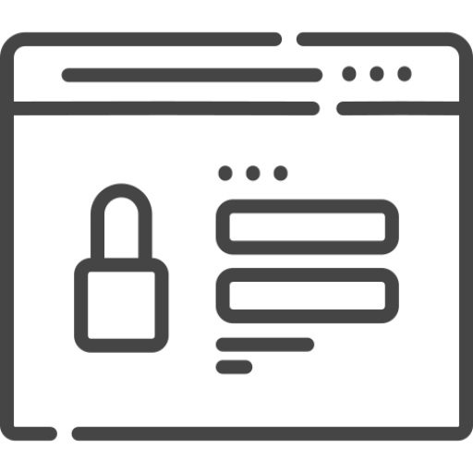
User Registration with Password Entry
Activating user accounts created by admins through password entry directed by confirmation email
Admin
[John Doe]
Application User
[Jane Doe]
Application User Profile
[Jane Doe]
User Account Confirmation Email
[Jane Doe]
Password Entry
[Jane Doe]

Slide 6
User Registration with Email Verification
Activating user accounts created by admins through email verification
Admin
[John Doe]
Application User
[Jane Doe]
Application User Profile
[Jane Doe]
User Account Confirmation Email
[Jane Doe]

Slide 7

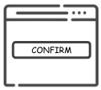
Self-Registration with REST API
Activating user accounts created by users via REST API
Application User
[Jane Doe]
POST /api/identity/user/v1.0/me
Self Registration
[Jane Doe]
User Account Lock Email
[Jane Doe]
Registration Confirmation
[Jane Doe]
User Account Confirmation Email
[Jane Doe]

Slide 8
Self-Registration with SCIM/Me
Activating user accounts created by users via SCIM2 API
Application User
[Jane Doe]
POST SCIM2/Me
Self Registration
[Jane Doe]
User Account Lock Email
[Jane Doe]
Registration Confirmation
[Jane Doe]
User Account Confirmation Email
[Jane Doe]

Slide 9
Password Policies

Slide 10

Password Input Validation
Configuring password validation criteria to verify the password strength
User Store
Identity Provider (IdP)
WSO2 Identity Server
Application User
[Jane Doe]
Exceeds maximum character length
Minimum character length not met
Includes repeated characters

Slide 11
Password Expiry
Prompting to change the password after a predefined duration
User Store
Identity Provider (IdP)
WSO2 Identity Server
Application User
[Jane Doe]
Password expiry

Slide 12
Password History
Restricting users from entering a recent password as the new password
User Store
Identity Provider (IdP)
WSO2 Identity Server
Application User
[Jane Doe]
Password history

Slide 13
Password Reset and Recovery

Slide 14

Password Reset
Users changing their forgotten or compromised passwords through verification steps
User Store
Identity Provider (IdP)
WSO2 Identity Server
Application User
[John Doe]

Slide 15


Password Recovery
Process of regaining access to an account after forgetting the password
User Store
Identity Provider (IdP)
WSO2 Identity Server
Application User
[John Doe]

Slide 16
Account Recovery

Slide 17
Account Recovery
Process of regaining access to an account after losing credentials or encountering issues.
User Store
Identity Provider (IdP)
---
WSO2 Identity Server
Application User
[John Doe]

Slide 18
Account Locking and Disabling

Slide 19
Account Locking
Temporary lock accounts and prevent accessing the system
User Store
Identity Provider (IdP)
WSO2 Identity Server
Admin User
[John Doe]
Exceeds the maximum acceptable no of failed login attempts

Slide 20
Quick Recap

Slide 21

User account attributes
User registration options
Password policies
Password reset and recovery
Account recovery
Account locking and disabling
What you learnt

Slide 22



Any Questions ?
Reach us through the following channels
iam-dev@wso2.org
https://stackoverflow.com/questions/tagged/wso2-identity-server
https://discord.com/invite/Xa5VubmThw

Slide 23
Thank you!
Notes:
Acknowledge that it’s been a lot of changes within the team
Thank you for your taking onboard the feedback and being open to change.
A lot of work , a lot of learning, sometimes feeling twice the exhaustion
But also hopefully seeing what I see, which is: better ways of working, more innovation in our approach, more business acumen, more effective reactivity , more ahead of the game. Because that’s where marketing needs to be.
All this in a context where it’s also been a lot of changes for WSO2.
And from this standpoint I wanted to remind you of what Sanjiva said about you owning the culture

